Slide 1
Data Visualization Project
Presented by Bethelhem Kassa
April 20,2022

Slide 2
Introduction
The project is about average time I spend everyday on social media specifically Facebook.
Facebook is one of the most known and widely used social media world wide.
Designed by Mark Zuckerberg in February 4, 2004.
Originally named theFacebook(https://ohfact.com/facebook-facts/).
According to McCoy, it has about 2.6 billion users.

Slide 3
Continued….
It has a lot of features but the main reason I use it:
To connect with family members and friends
To find some stuffs on its marketplace
To get reminders about important life events of my family members and friends(birth day, anniversary etc)

Slide 4
Data collected
Table 1: collected data
Date | Time_Spent(in minutes)
4/1/2022 | 13
4/2/2022 | 10
4/3/2022 | 9
4/4/2022 | 38
4/5/2022 | 14
4/6/2022 | 25
4/7/2022 | 20
4/8/2022 | 45
4/9/2022 | 17
4/10/2022 | 34
4/11/2022 | 15
4/12/2022 | 26
4/13/2022 | 16
4/14/2022 | 15
4/15/2022 | 10
4/16/2022 | 13
4/17/2022 | 30

Slide 5
Data Analysis
According to broadbandsearch.net, average time spent daily on Facebook is 58 minutes
Question for the analysis:
Is my average time spent daily on Facebook is significantly different from 58 minutes as claimed by broadbandsearch.net?
For data visualization, line graph was used. Since it depicts the trend over time.
One sample t-test will be used to test the claim and significance level of 0.05.

Slide 6
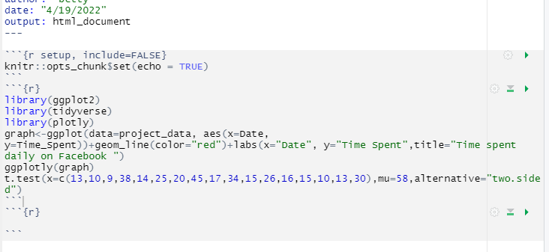
R code for Data Analysis

Slide 7
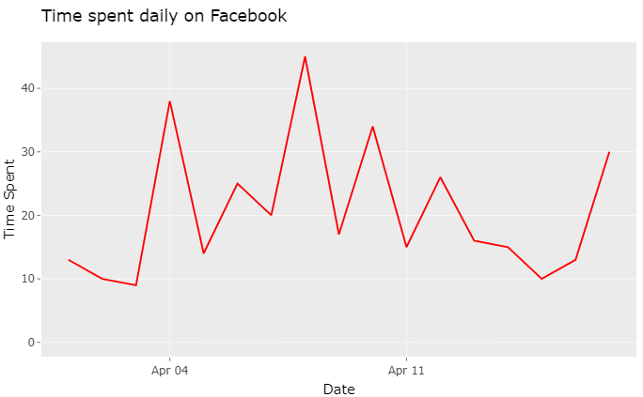
Graph 1: Line Graph

Slide 8
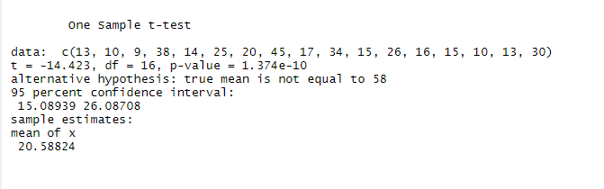
Output for the t-test

Slide 9
Continued…
Step 1: Hypothesis: the null(Ho) and alternative hypothesis(Ha)
Ho: µ = 58 ; Ha: µ != 58
Step 2: One sample t-test
Step 3: Test statistic: t= -14.42 and P-value=1.374e-10
Step 4: Make a decision: Reject Ho, since p-value < α
:There is sufficient evidence to support the claim that the average time I spent daily on Facebook is significantly different from 58 minutes

Slide 10
References
25 Amazing facts about Facebook, McCoy J., July 12, 2020 https://www.searchenginejournal.com/facebook-facts/359408/#close
17 Interesting facts about Facebook, https://ohfact.com/facebook-facts/
Average time spent daily on social media(Latest 2022 data)
https://www.broadbandsearch.net/blog/average-daily-time-on-social-media#:~:text=Social%20media%20companies%20don%27t%20generally%20release%20information%20about,on%20average%2C%20according%20to%20a%20study%20by%20SimilarWeb.

